Slide 1
Title: European Bank’s Customer Churn Analysis & Prediction
Sathiswaran Sangaran

Slide 2
Introduction & Executive Summary
What is Churn?
Churn is a term that refers to the number of customers that a company(bank) loses over a specific time period either by closing their account.
Cost of Customer Acquisition
5-25 times more expensive than retaining existing customers
Profit from Customer Retention (5%)
25-95 % profit increase
Problem Statement:
Customer churn is a critical issue for businesses in a competitive markets. Understanding and predicting churn can help bank to strategize proactive measures on customer retention, improve customer satisfaction and service, and therefore increasing revenue.
Oliver Wyman. (2021, March). Banking-as-a-Service enables up to 95 percent cost saving in acquiring customers. Retrieved from https://www.oliverwyman.com/media-center/2021/mar/banking-as-a-service-enables-up-to-95-percent-cost-saving-in-acquiring-customers.html
Rajendran, S., Devarajan, R., & Elangovan, G. (2023, January). Customer churn prediction using machine learning approaches. 2023 International Conference on Engineering, Technology, and Applied Science (ICECONF). https://doi.org/10.1109/ICECONF57129.2023.10083813
Comprehensive Consulting Solutions for Small Businesses. (n.d.). Customer Acquisition Costs Five Times More than Customer Retention. Retrieved June 30, 2024, from https://www.comprehensiveconsultingsolutionsforsmallbusiness.com/customer-acquisition-costs-five-times-more-than-customer-retention/

Slide 3
Stakeholders & Goals
Bank Executives
Sustainable revenue and long term success
1
Marketing Team
Targeted strategies that improve customer loyalty.
2
Customer Service
Preventive measures that reduce complaints and improve customer satisfaction
3
Goals:
To improve customer retention
Develop ML models to predict churn
Provide actionable insights for bank management

Slide 4
1
2
3
4
IDENTIFY
The Data
TRAIN
The models
DEVELOP
Strategies
DEPLOYMENT
Of the Model

Slide 5
Identify Data
Variables
Numerical
1) Credit Score
2) Age
3) Balance
4) Estimated Salary
Categorical
1)Geography
2)Gender
3)Tenure
4)No of products
5)Has Credit card
6)Active member
Dataset: 10,000 rows x 14 columns
Missing Data: Steps to handle missing data. (Geography & gender)
Encoding Categorical Features:
Label Encoding for binary categorical features (Gender).
One-Hot Encoding for multi-class categorical features (Geography).
Drop: Row number, Customer ID, Surname
Responding Variable: Exited

Slide 6
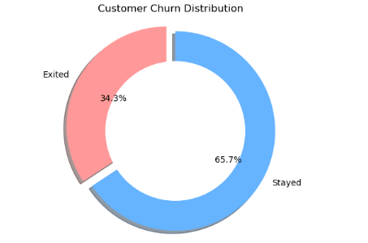
Exploratory Data Analysis Findings
Customer Churn Rate
Total Customer: 18, 869
Customer Churn Rate: 34.3%
 | Count | Percentage
Stayed | 12, 427 | 65.7%
Exited | 6,442 | 34.3%

Slide 7
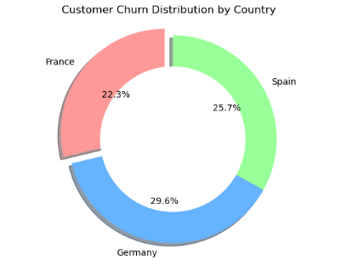
Customer Churn Rate by Country
 | Count | Churn Count | Percentage
France | 10,352 | 2,304 | 22.3%
Germany | 7,635 | 2,257 | 29.6%
Spain | 7,324 | 1,881 | 25.7%
Total | 18,869 | 6,442 | 100%
Geography: Higher exits in Germany, lowest in France.

Slide 8
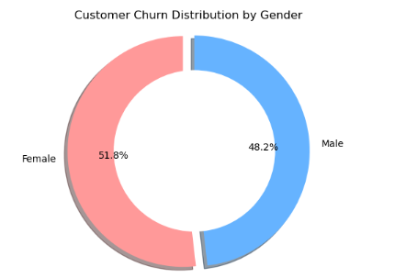
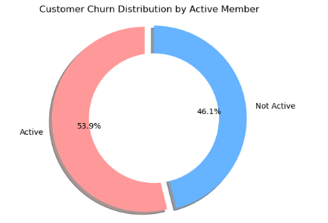
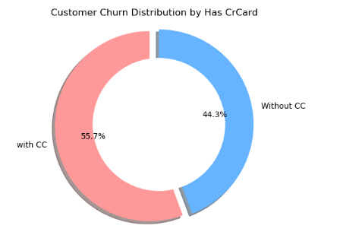
 | Count | Percentage
Female | 3,336 | 51.8%
Male | 3,105 | 48.2%
 | Count | Percentage
Active | 3,475 | 53.9%
Not Active | 2,967 | 46.1%
 | Count | Percentage
With CC | 3,589 | 55.7%
Without CC | 2,853 | 44.3%
Gender: Higher exit proportion for females.
Is Active Member: Higher exit proportion for not active members.
CrCard: Higher exit proportion with CC

Slide 9
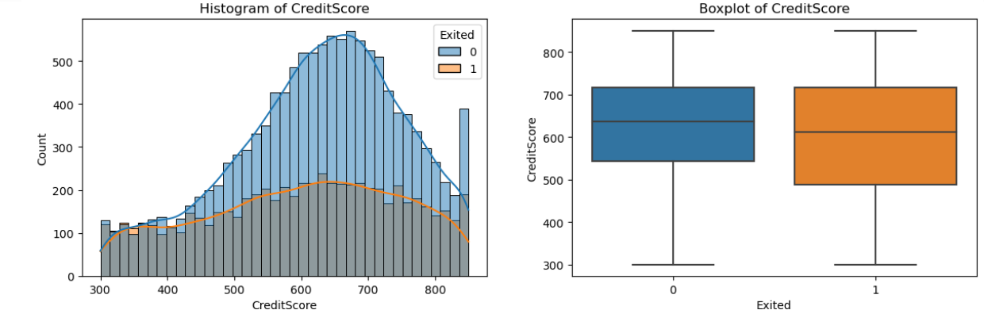
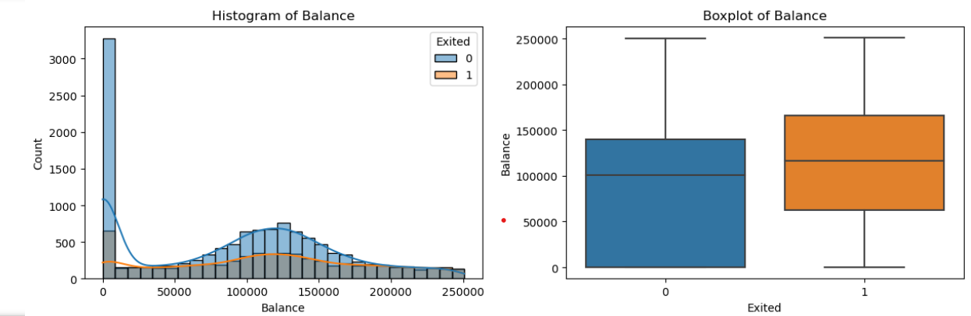
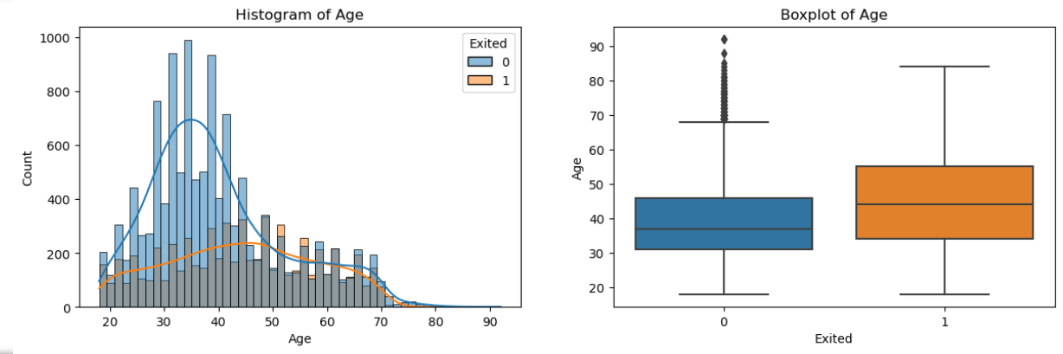
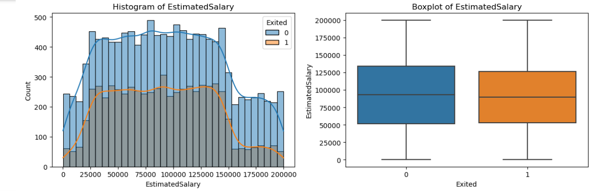
Continuous Numerical Variables
Credit Score: Slightly lower median for exited customers. Median credit score for customers who exited: 611.0 compared to 637.0 for those who did not exit.
Balance: Higher median balance for exited customers. Range of balance for customers who exited: 0 𝑡𝑜 250,898.09 with a median balance of $116,760.60
Age: Older customers are more likely to exit. Mean age of customers who exited is 44 compared to 39 for those who did not exit.
Estimated Salary: Similar distributions, suggesting it might not be a significant factor for churn.

Slide 10
Summary of EDA
Customers who are more likely to churn are:
1) High balance customers
2) Older Customers
3) Customer with Fewer products
4) Non active customers
5) Customers in Germany

Slide 11


Literature Review
Approach
Data Collection & Preprocessing
Exploratory Data Analysis (EDA)
Develop ML Model
Data Preprocessing
Handling Missing Values: Mode values for
'Geography', 'Gender’
Encoding: Label Encoding, One-Hot Encoding
Class Imbalance: SMOTE
Scaling: StandardScaler
Exploratory Data Analysis
Histograms, Boxplots, donut chart
Model Training
Data Splitting: Training, Testing sets
Algorithms: Logistic Regression, Random Forest, Gradient Boosting, AdaBoost, KNN
Model Tuning
Hyperparameter Tuning: Random Forest,
Gradient Boosting
Model Evaluation
Performance Metrics: Accuracy, Precision,
Recall, AUC

Slide 12
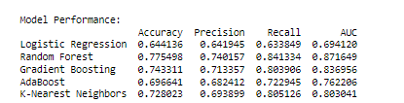
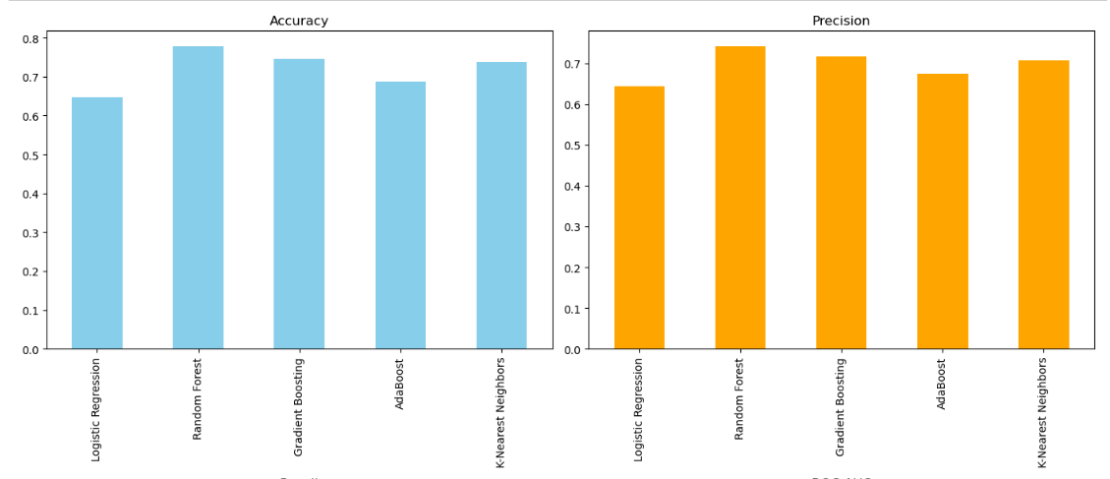
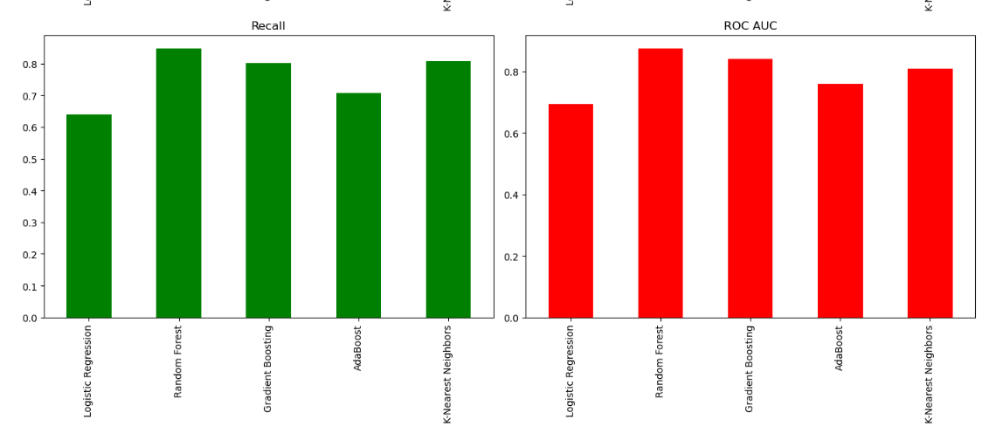
Model Performance
Evaluation Results:
Random Forest: Best performance in
Accuracy (77.5%),
Precision (74.0%),
Recall (84.1%),
AUC (0.872).
Gradient Boosting: Strong alternative.
Conclusion:
The analysis highlights the critical factors influencing customer churn and identify effective machine learning model in predicting churn.

Slide 13
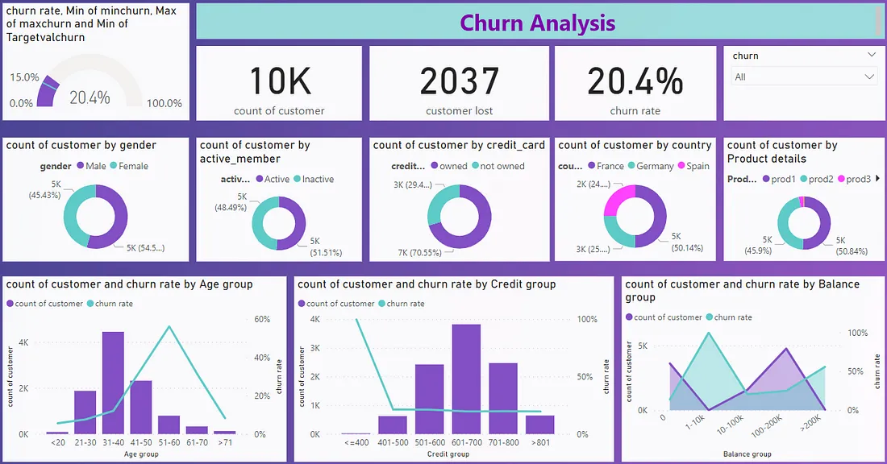
Recommendation on Future Work: Deployment
Dashboard with the machine learning model developed
Objective: Real-time monitoring of customer behavior and churn rate.
Review the analysis in Biweekly management meeting
Make sure strategies aligns with the data pattern reflection on customer behaviour.
Features:
Live (Churn rate, customer count, customer lost)
Donut charts for:
customers and churn rate by gender, activity status, credit card status, country, churn rate, no of products.
Line bar charts for:
customers and churn rate by age group, credit score, balance.

Slide 14
Actionable Insights for Customer Retention Strategies:
Customers who are more likely to Churn | Retention Strategies
High balance customers | Personalized Services: Assign dedicated relationship managers. Exclusive Benefits: Offer premium banking services and rewards. (Low interest loan, insurance, credit card with special benefits. Reward Programs: Implement loyalty programs.
Older Customers | Financial Planning Services: Provide retirement planning and investment advice. Long-Term Relationship Building: Focus on trust and personalized interactions. Health and Wellness Programs: Offer health-related financial services.
Customers with Fewer Products | Cross-Selling Campaigns: Encourage adoption of additional products. Bundling Discounts: Offer incentives for product bundling. Product Education: Educate on benefits of additional services.
Non-Active Customers | Reactivation Campaigns: Launch targeted campaigns with incentives. Digital Engagement: Enhance digital platforms for convenience. Exclusive Benefits: Offer premium banking services and rewards. (Low interest loan, insurance, credit card with special benefits
Germany Customers | Localized Offerings: Customize marketing and products. Community Engagement: Participate in local initiatives.

Slide 15
Thank you

Slide 16
References:
Harvard Business Review. (n.d.). The Value of Keeping the Right Customers. Retrieved June 30, 2024, from https://hbr.org/2014/10/the-value-of-keeping-the-right-customers
Outbound Engine. (n.d.). Customer Retention Marketing vs. Customer Acquisition Marketing. Retrieved June 30, 2024, from https://www.outboundengine.com/blog/customer-retention-marketing-vs-customer-acquisition-marketingComprehensive Consulting Solutions for Small Businesses. (n.d.). Customer Acquisition Costs Five Times More than Customer Retention. Retrieved June 30, 2024, from https://www.comprehensiveconsultingsolutionsforsmallbusiness.com/customer-acquisition-costs-five-times-more-than-customer-retention/
VWO. (n.d.). What is Customer Retention? 12 Practical Strategies That Help. Retrieved June 30, 2024, from https://vwo.com/blog/what-is-customer-retention-strategies/
Oliver Wyman. (2021, March). Banking-as-a-Service enables up to 95 percent cost saving in acquiring customers. Retrieved from https://www.oliverwyman.com/media-center/2021/mar/banking-as-a-service-enables-up-to-95-percent-cost-saving-in-acquiring-customers.html
Rajendran, S., Devarajan, R., & Elangovan, G. (2023, January). Customer churn prediction using machine learning approaches. 2023 International Conference on Engineering, Technology, and Applied Science (ICECONF). https://doi.org/10.1109/ICECONF57129.2023.10083813

